Slide 1
T863203 LOCATION TECHNOLOGIES
SHORT RANGE POSITIONING
Senior Lecturer Riitta Rontu, M.Sc (Eng.)
Oulu University of Applied Sciences

Slide 2
Indoor positioning
Indoor Positioning is defined as any system that attempts to provide an accurate position inside of a covered structure, such as an Airport, a Subway, or a Mall. It is generally implied that modern indoor positioning systems do not use GPS Satellites in any way.
Indoor Positioning has different demands from outdoor positioning. In many cases the accuracy is not the most important point; often it is adequate to know the location referred as room number or such.
Location Technologies 2013 /RR
3.2.2013

Slide 3
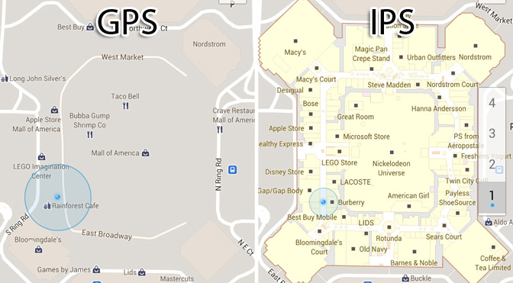
IPS (Indoor Positioning System)
Location Technologies 2013 /RR
3.2.2013

Slide 4
RTLS (Real Time Location System)
Identify AND locate
Vision: Every person and object in a building is identified and located in real-time
RTLS is usually referring to indoor tracking or local positioning (contrary to outdoor GPS)
Anchors (fixed points) are used to measure location
Location Technologies 2013 /RR
3.2.2013

Slide 5
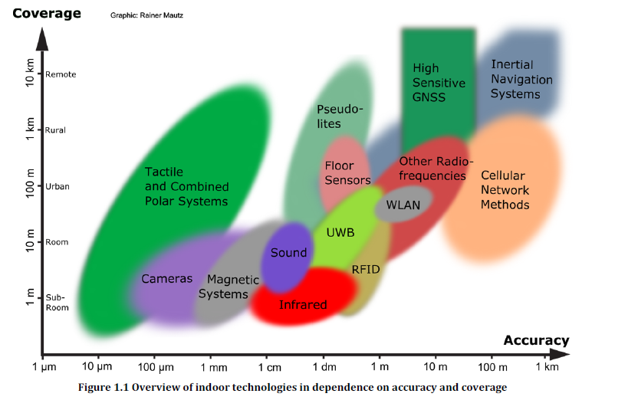
Location Technologies 2013 /RR
3.2.2013

Slide 6
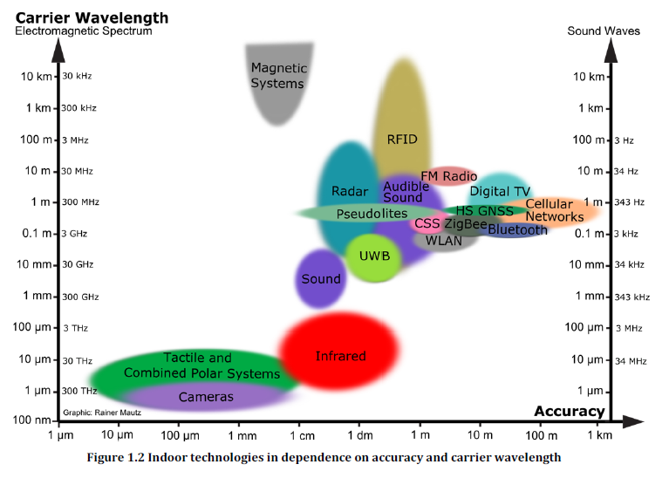
Location Technologies 2013 /RR
3.2.2013

Slide 7
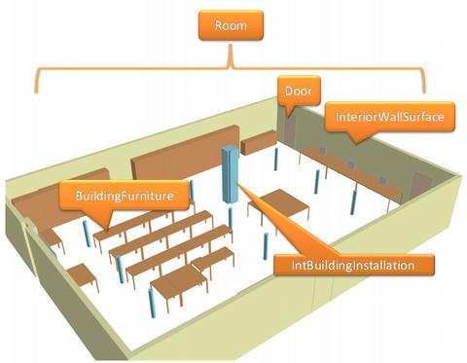
Indoor environment causes problems
Location Technologies 2013 /RR
3.2.2013

Slide 8
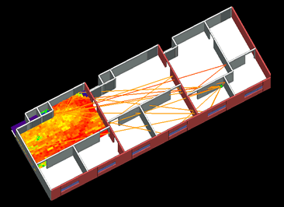
Indoor propagation
Location Technologies 2013 /RR
3.2.2013

Slide 9
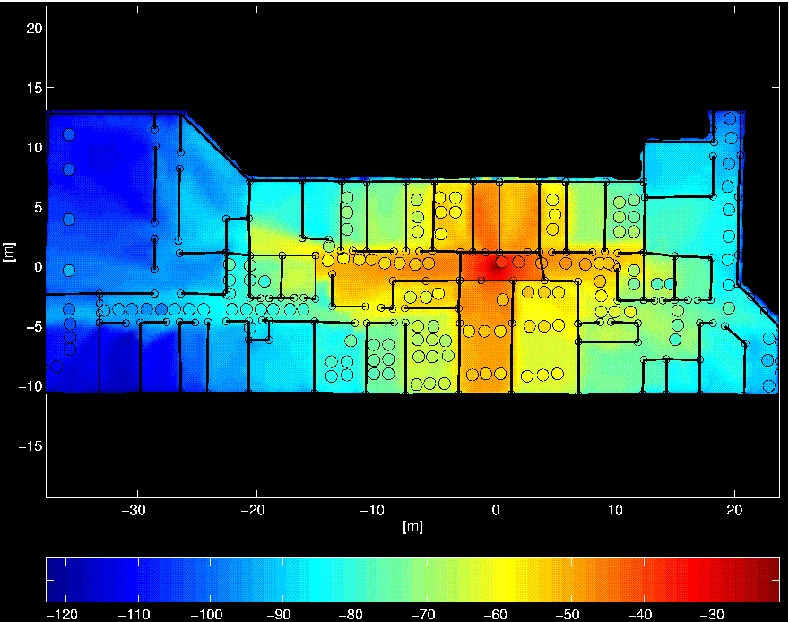
Location Technologies 2013 /RR
3.2.2013

Slide 10
Indoor Propagation
Indoor propagation is very different to outdoor propagation. Especially methods that are based on trilateration can have serious problems
Problems are caused by
  Reflections from different surfaces
  Diffraction from walls, furniture and other obstacles
  Attenuation caused by moving crowds of people
Location Technologies 2013 /RR
3.2.2013

Slide 11
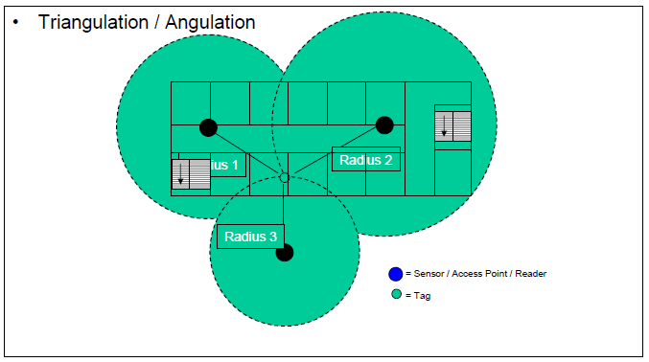
Methods in Indoor Positioning: Triangulation
Location Technologies 2013 /RR
3.2.2013

Slide 12
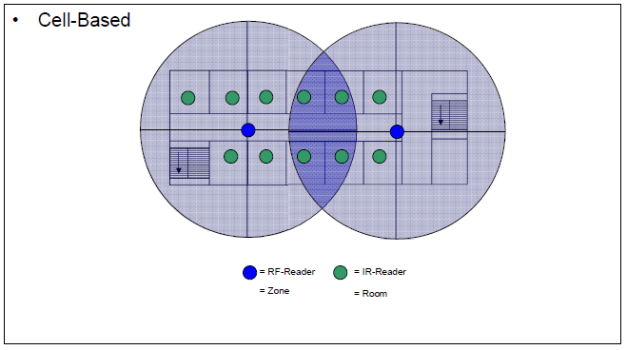
Methods in Indoor Positioning: Cell-based
Location Technologies 2013 /RR
3.2.2013

Slide 13
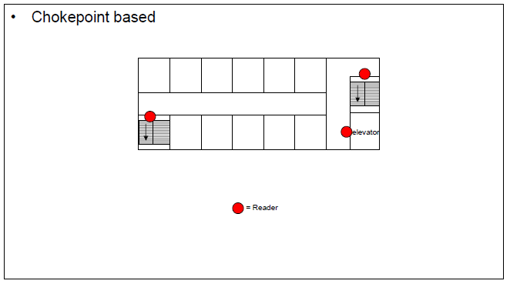
Methods in Indoor Positioning: Chokepoint based
Location Technologies 2013 /RR
3.2.2013

Slide 14
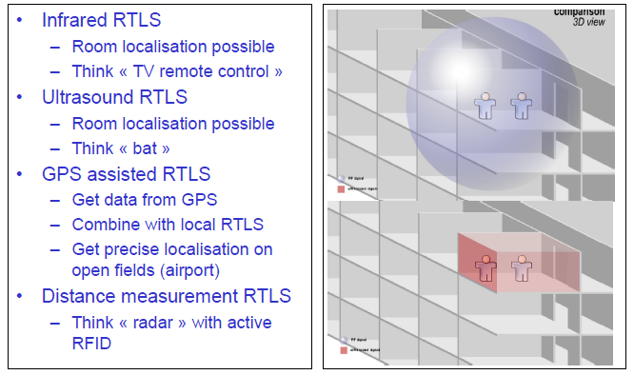
Tomorrow’s RTLS Systems (combined technologies)
Location Technologies 2013 /RR
3.2.2013

